Slide 1
IFIEC VISION OF A LIBERALISED EUROPEAN GAS MARKET
Energy Forum, 22 Nov. 2011
Steinar Solheim, Chairman of Working Party Oil & Gas

Slide 2
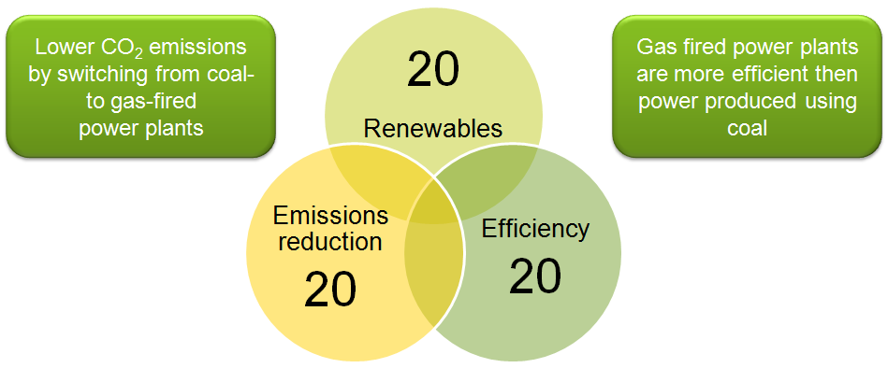
Gas will be important in order to reach the 20-20-20 target

Slide 3
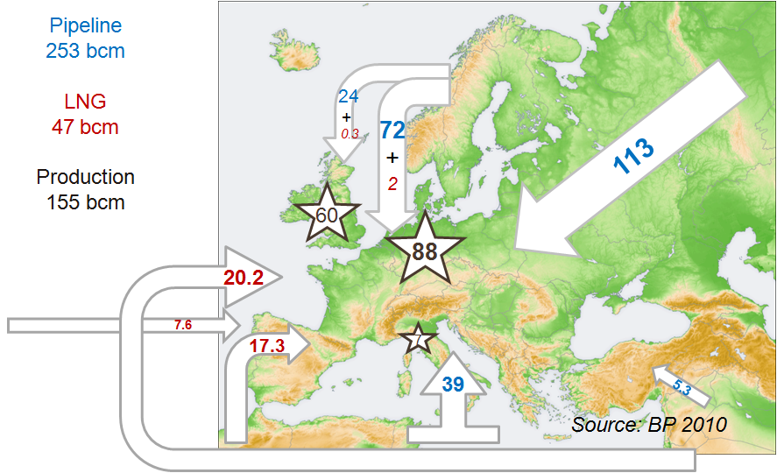
Gas flowing to Europe North, Central, Southern Europe in bcm

Slide 4
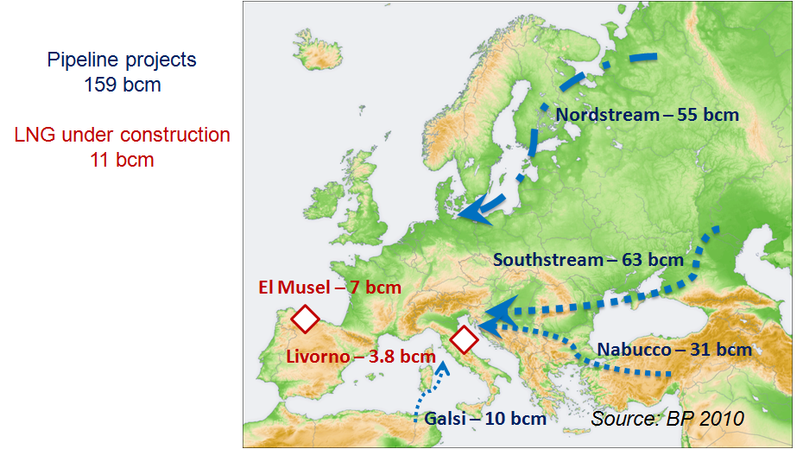
New import capacity

Slide 5
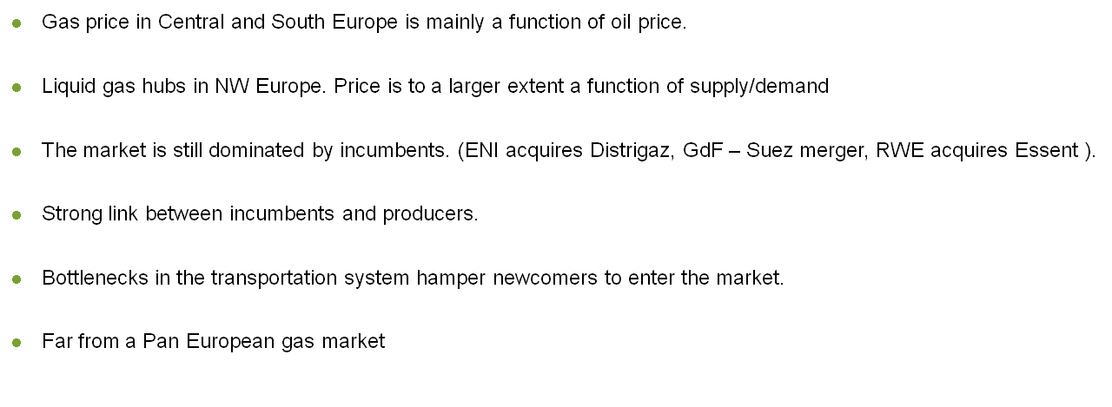
CHARACTERISTICS OF THE EUROPEAN GAS MARKET

Slide 6
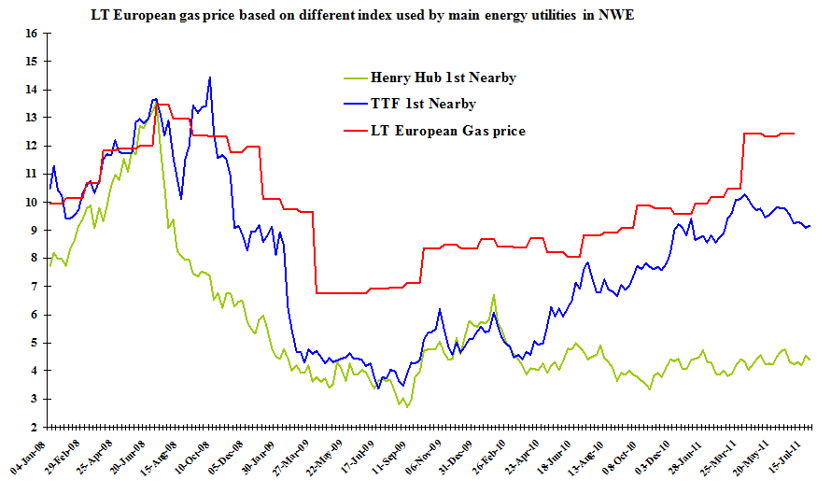
Market gas price versus European LT gas price

Slide 7
EUROPEAN COMMISSION: ENERGY 2020 (DEC2010)

Slide 8
ITALY - AN EXAMPLE OF A NON COMPETITIVE MARKET

Slide 9
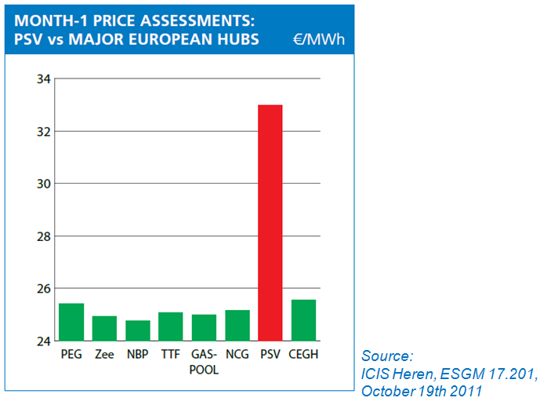
European Gas Hub Prices

Slide 10
GAS TARGET MODEL (1)

Slide 11
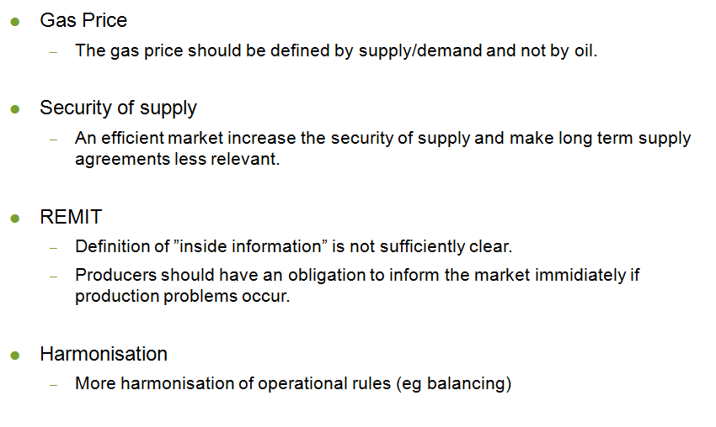
GAS TARGET MODEL (2)

Slide 12
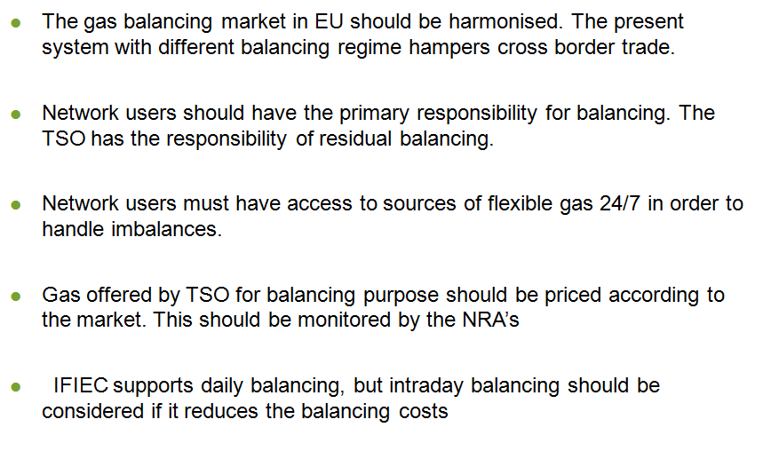
Gas Balancing (1)

Slide 13
Gas Balancing (2)

Slide 14
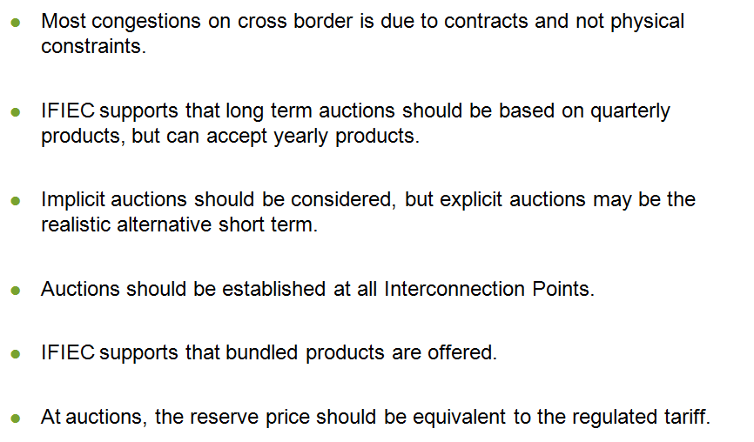
Capacity Allocation Mechanisms

